Slide 1

Quarterly Financial Report
FY2024 2nd Quarter
07/01/2023 – 12/31/2023
JANUARY 22, 2024

Slide 2
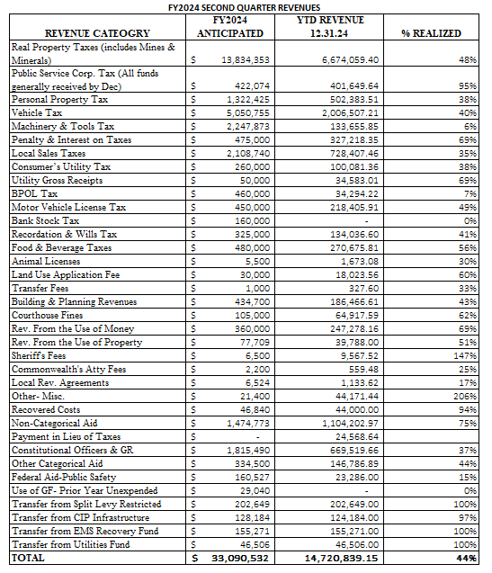

Slide 3
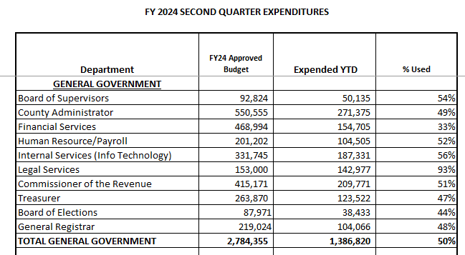

Slide 4
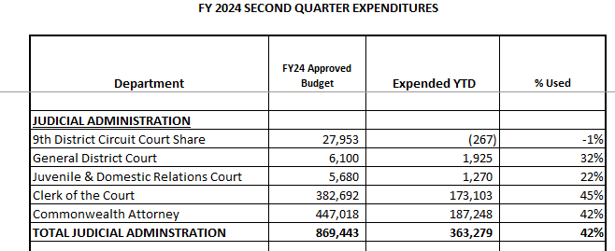

Slide 5
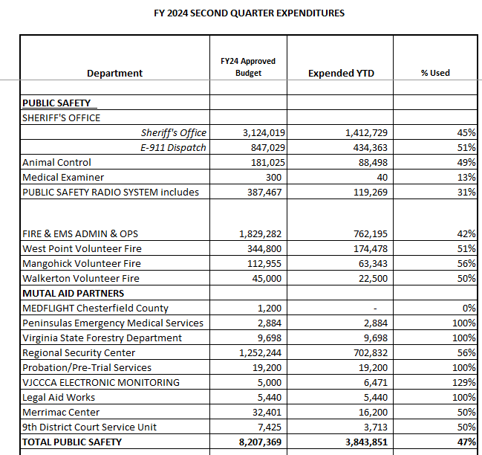

Slide 6
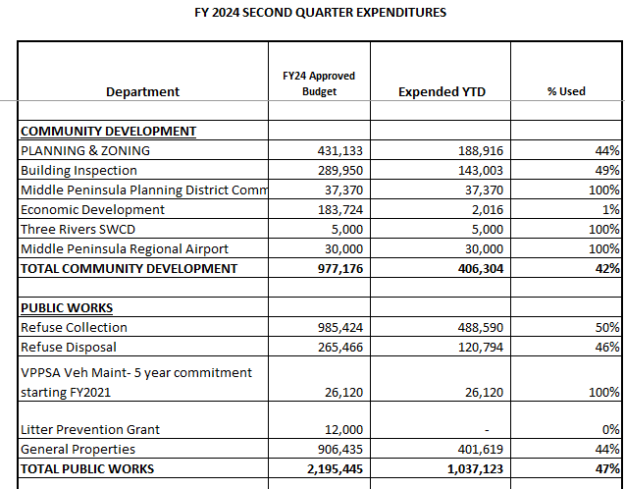

Slide 7
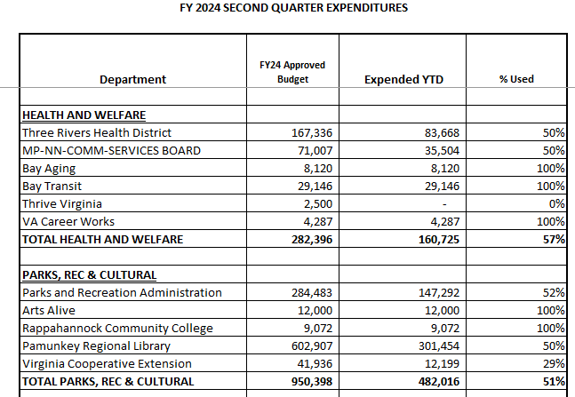

Slide 8
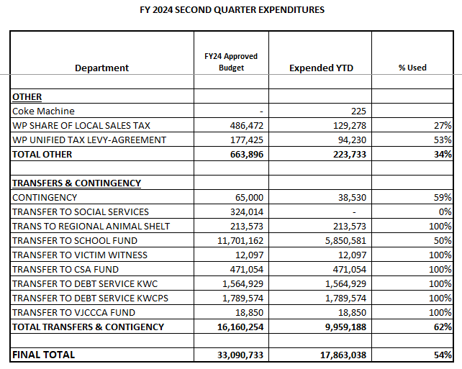

Slide 9
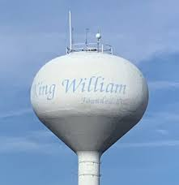
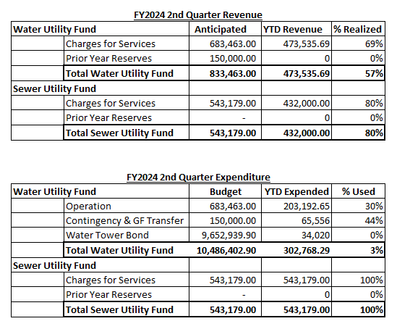
Utilities Summary
Projects Update
Water Tower Pipe RFP 23-001 - Fortiline
Water Main RFP 24-002 – Walter C. Via Enterprises
Water Tower RFP 24-005 – Landmark Structures

Slide 10


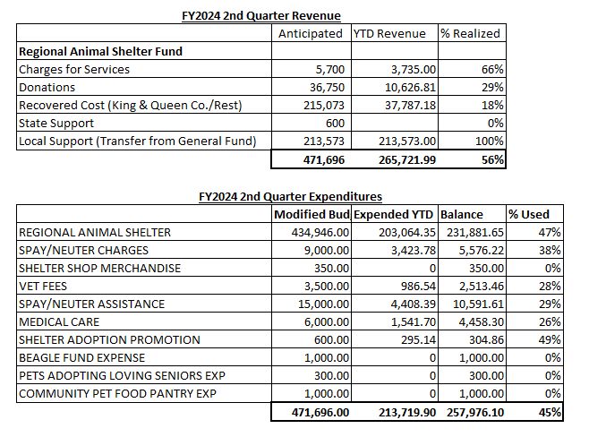

Slide 11

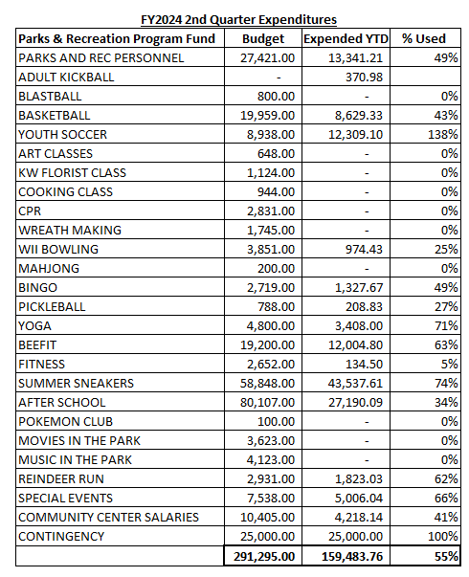
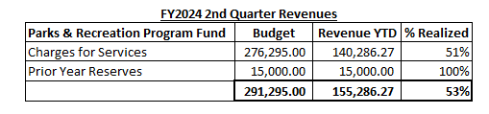
Events
Basketball Season
Soccer - Sign up for the spring season is available and P&R is looking for sponsors
Little Kooker’s – February 3
Yoga – Every Tuesday and Thursday
Beefit – Monday, Wednesday and Saturdays
Fit & Feisty – Weekdays
Pickleball – Wednesday and Saturdays
Wii Bowling – Fridays
Mahjong - Wednesdays

